Slide 1
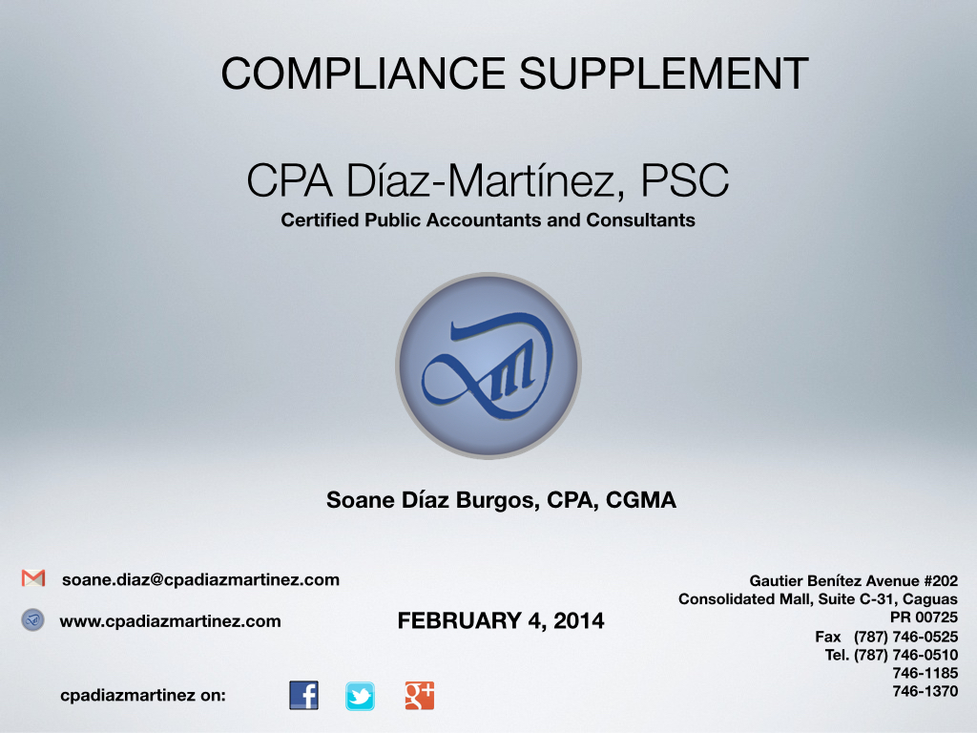

Slide 2

Compliance Supplement
What is the Compliance Supplement
Important sections of the CS
For what should or should not be used
New Information for CS 2015
COMPLIANCE SUPPLEMENT

Slide 3
What is the Compliance Supplement?

Slide 4
What is the Compliance Supplement?
  “The Compliance Supplement is based on the requirements of the 1996 Amendments and 1997 revisions to OMB Circular A-133, which provide for the issuance of a compliance supplement to assist auditors in performing the required audits.”

Slide 5
What is the Compliance Supplement?
  Studies of the single audit process performed by the Government Accountability Office (GAO), the President’s Council on Integrity and Efficiency, and the National State Auditors Association (NSAA), supported the need for a current compliance supplement.

Slide 6
What is the Compliance Supplement?
  Benefits:
    Helps determine those direct and material compliance requirements applicable to federal awards.
    Provides an overview of program requirements, objectives and procedures of federal awards.
    Provides updates of changes in program regulations, objectives and procedures.

Slide 7

What is the Compliance Supplement?
  Benefits:
    For programs not included in the compliance supplement, provides guidance to determine applicable compliance requirements that are direct and material.

Slide 8
What is the Compliance Supplement?
  Applicability of Final OMB Grant Guidance
Nonfederal entities new guidance will be effective for all federal awards or funding increments provided after 12/26/14.
New guidance Subpart F will apply to audits of FY BEGINNING ON or AFTER 12/26/14. Early implementation NOT PERMITTED.

Slide 9
What is the Compliance Supplement?
  Actually is a separate document.
  Under the Final OMB Grant Guidance, the Compliance Supplement is the Appendix XI to part 200.
  Will continue to be updated annually.

Slide 10
Important Sections of the Compliance Supplement

Slide 11
Important Sections of the CS
  PART 1 – Background, Purpose, and Applicability
    Background – why the CS
    Purpose and Applicability
    Overview of the CS
    Technical Information
    How to obtain additional Guidance

Slide 12

Important Sections of the CS
  PART 2 – Matrix of Compliance Requirements
    Helps identify the compliance requirements that applies
    Important – What the “Y” means???

Slide 13
Important Sections of the CS

Slide 14
Important Sections of the CS
  PART 3 – Compliance Requirements (CR)
    Provides generic audit objectives and audit procedures to most of the compliance requirements.
    Administrative Requirements:
      A-102 – Common Rule - “Uniform Administrative Requirements for Grants and Cooperative Agreements to State and Local Governments”

Slide 15
Important Sections of the CS
  PART 3 – Compliance Requirements (CR)
    Administrative Requirements:
      A-110 – 2 CFR part 215 - “Uniform Administrative Requirements for Grants and Agreements with Institutions of Higher Education, Hospitals, and Other Non-Profit Organizations.”
      Others included in part 4 & 5 of CS

Slide 19
Important Sections of the CS
  PART 4 – Agency Program Requirements
    Provides:
      program objectives and procedures for each federal program included in the CS (except R&D and SFA)
      Information about compliance requirements specific to a program.
      Other Information

Slide 20
Important Sections of the CS
  PART 4 – Agency Program Requirements
    Whenever on the following CR are applicable to a program included in the CS, this part provides specifics of the requirements:
      A – Activities Allowed or Unallowed
      E – Eligibility
      G – Matching, Level of Effort, & Earmarking
      L – Reporting
      N – Special Tests and Provisions

Slide 21
Important Sections of the CS
  PART 4 – Agency Program Requirements
    The other nine CR generally are not specific to a program, and therefore, are not included in this part.
    Descriptions of CR included in parts 3 & 4 are generally a summary of actual CR. Refer to laws and regulations referenced to obtain complete information.

Slide 22
Important Sections of the CS
  PART 4 – Agency Program Requirements
    What happens to RD&A and SFA?
      Part 5 is the equivalent of Part 4 for these programs.
      Auditors will need to consider information provided in Parts 2, 3 and 5 to develop the audit programs.

Slide 27


Slide 32
Important Sections of the CS
  PART 5 – Cluster of Programs
    Defined by Circular A-133 §___.105:
      Federal programs with different CFDA numbers that are defined as a cluster of programs because they are closely related programs that share common compliance requirements.
    Identifies R&D and SFA programs.
    Defines other programs not included in the CS.

Slide 40
Important Sections of the CS
  PART 6 – Internal Controls (I/C)
    Describes the objectives and certain characteristics of I/C that, if are in place and working properly, may ensure compliance with program requirements.
    I/C characteristics described are based on the context of the components of I/C discussed in Internal Control-Integrated Framework (COSO Report), published by the Committee of Sponsoring Organizations of the Treadway Commission

Slide 41
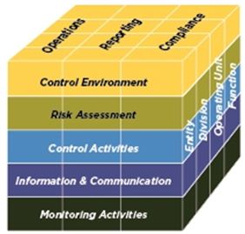
Important Sections of the CS
  PART 6 – Internal Controls (I/C)

Slide 45
Important Sections of the CS
  PART 7 – Guidance for Auditing Programs not Included in this CS
    Provides guidance to auditors on how identify CR that are applicable for programs not included in the CS for Single Audits and Program Specific Audits when guide is not available.

Slide 46
Important Sections of the CS
  PART 7 – Guidance for Auditing Programs not Included in this CS
    Important:
      Auditors have responsibility under Generally Accepted Government Auditing Standards (GAGAS) for other requirements when specific information comes to the auditors’ attention that provides evidence concerning the existence of possible noncompliance that could have a material indirect effect on a major program.

Slide 47
Important Sections of the CS

Slide 48
For what should or should not be used

Slide 49

For what should or should not be used
  IT’S NOT A CHECKLIST
  IT’S NOT AN AUDIT PROGRAM

Slide 50

For what should or should not be used
  IT’S A GUIDE
  Provides information that helps in the identification of compliance requirements to be tested.

Slide 51
NEW INFORMATION FOR COMPLIANCE SUPPLEMENT 2015

Slide 52
New Information for CS 2015
  Davis Bacon Act – deleted from Part 2, 3 and 4. If a program retained this requirement for audit purposes, should be included in “Special Tests and Provisions” on Part 4.
  Real Property Acquisition and Relocation Assistance – DELETE
  Part 3 – NEW PART 3.2 – used by auditors required to use the Uniform Guidance.

Slide 53

New Information for CS 2015
  Reporting – FFATA requirements:

Slide 54



